Slide 1
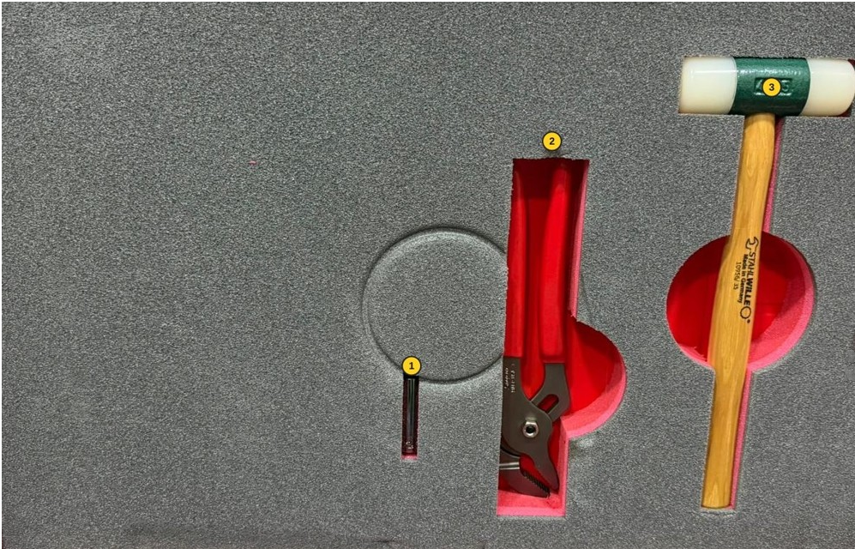
P1

Slide 2
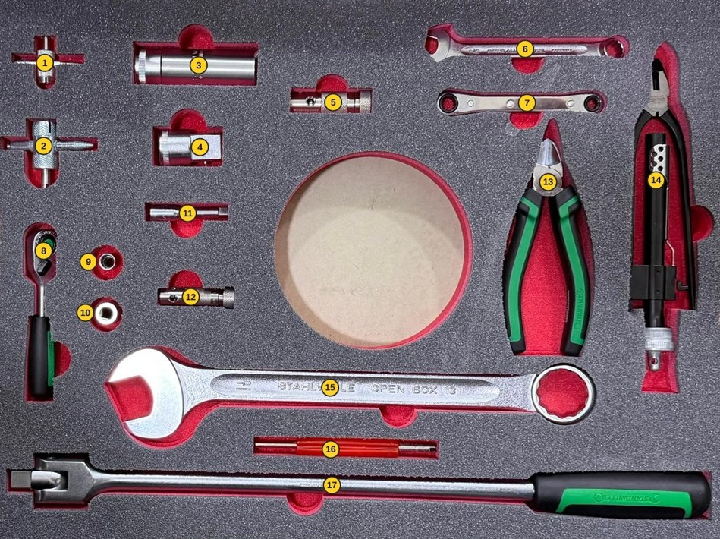
P2

Slide 3
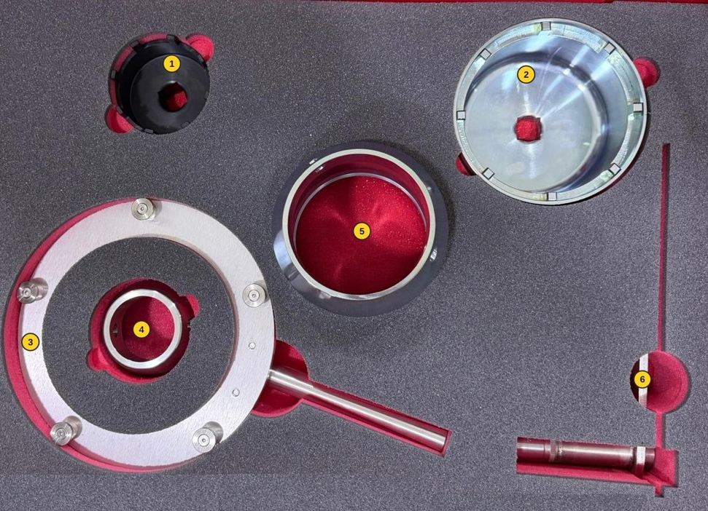
P3

Slide 4


A321 Wheel Change Kit
P/N: SCA-SAS321-010
AHY-T0035

